Slide 1

Swap IFB for Inter Broker
Proejct Denali
November 2026
Confidential & Trade Secret

Slide 2
MJM HOLDINGS
TBU – BP/TG to write
Situation Update
SUMMARY
MJM Holdings (“MJM” or the “Company”) has continued to make progress across the Company’s key initiatives:
MJM Holdings (“MJM” or the “Company”) has continued to make progress across the Company’s key initiatives:
  Following MJM’s acquisitions of GIA in 2025 and Leadenhall in 2024, the Company is now the 6th largest insurance broker in Poland after Marsh, Aon, Grupa MAK, PIB (UK broker owned by Apax) and Willis, as well as the 2nd largest domestic broker. This is up from 9th place when Corsair first invested (and 5th largest domestic broker)
  Current trading continues to advance versus Corsair’s Base Case, with May 2026 LTM EBITDA of PLN 76.1mm and December 2025 EBITDA of PLN 68.2mm comparing to the December 2025 Underwriting Case of PLN 65.1mm
  In addition, initiatives including the establishment of a new Broker IT system as well as ERP continue to make progress, with target completion in Q4 2026
MJM is currently evaluating 5 M&A targets, of which 1 is in exclusivity and near-signing, 1 is a bilateral process with an LOI accepted and 3 are sales processes with LOIs submitted
  All acquisitions have been sourced by Company Management. Diligence on all assets is advancing, and the Company is assessing the opportunities available. If MJM is able to execute all 5 acquisitions, this would contribute c.PLN 30mm EBITDA
  M&A targets currently being evaluated would continue to add scale and diversify the profile of MJM post-acquisition with additional products and capabilities (e.g. guarantees, trade credit)
  The acquisitions being evaluated remain financially accretive with post-synergy multiples below Corsair’s entry acquisition multiple of 12.0x. Completing all deals would require up to ~$38mm of equity with one larger target in particular, Maximus, a local government focused broker, representing $25mm of that
In addition, the Deal Team is evaluating the opportunity to conduct a secondary purchase of shares from exited managers and founders
  We are in negotiations to acquire the ~7% stake held by the selling shareholders of Leadenhall in November 2026. They are no longer operationally involved in the business and wish to realize cash proceeds in order to fund US expansion in their software development business
  With a $14mm secondary opportunity requiring new equity, the price negotiated is attractive at a 15% discount to the Corsair Q1 FY26 fair value⁽¹⁾ and 11.9x FY26E EBITDA, reflecting only the accrued value of preference shares and no value to the ordinary shares
  In addition, we intend to explore the acquisition of the 2% stake held by Dariusz and Iwona Pokrowska, founders of Attis who sold their business to MJM Holdings in 2020 and are no longer active in the Company, which would be an additional $4mm opportunity
The equity requirement of the secondary purchase is $14-18mm⁽²⁾, while up to $38mm of follow-on equity would be required to fund all M&A currently in pipeline, of which $13mm would be required if Maximus does not sign
  Follow-on equity would need to be raised from third-party sources, with $5mm allocated in Corsair Fund VI to invest in MJM Holdings
  Other shareholders would be able to exercise their pre-emptive rights and participate. Contribution from Federated Hermes is to be confirmed but pro-rata would be c.$11mm, and MJM Management have also expressed interest in investing a portion of their pro-rata participation
  Ultimate terms and approval of any transaction would be subject to both Corsair and Board approval, providing the Deal Team with control over the pricing and terms of any individual transaction
INVESTMENT OPPORTUNITY
MJM Holdings (“MJM” or the “Company”) has continued to make progress across the Company’s key initiatives:
Source: Company information, Polish Broker Almanac, Corsair analysis.
(1) Pro-forma for the FY26E M&A pipeline.
(2) The acquisition of the stake held by Dariusz and Iwona Pokrowska is assumed to be acquired on the same terms as the stake acquired from the selling shareholders of Leadenhall. Excluded from returns calculations given the price is not agreed.

Slide 3
MJM HOLDINGS
Table of Contents
Overview of MJM Company Overview Key Investment Highlights MJM’s Journey Overview of MJM’s Product Offering M&A Update Exit Considerations | 4
Polish Insurance Distribution Market Overview of Players Active in Polish Insurance Brokerage Market Overview | 11
MJM Financial Profile Financial Performance and Business Plan May 2026 YTD Trading M&A & Secondary Returns Outlook and Sensitivities | 14
Appendix Unity Brokerage Group Company Overview Invictus Broker Company Overview Inter Broker Company Overview Insurance Brokerage Precedent Transactions Publicly Traded Comparables | 18

Slide 4

Overview of MJM

Slide 5
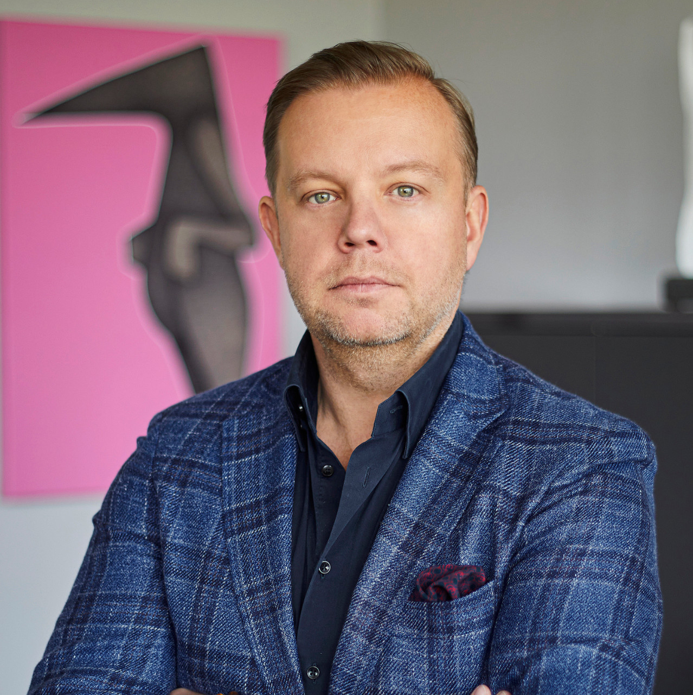



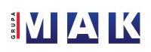
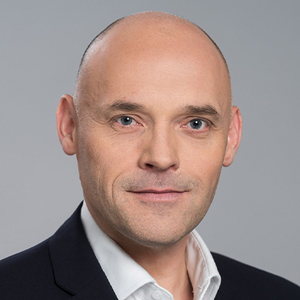


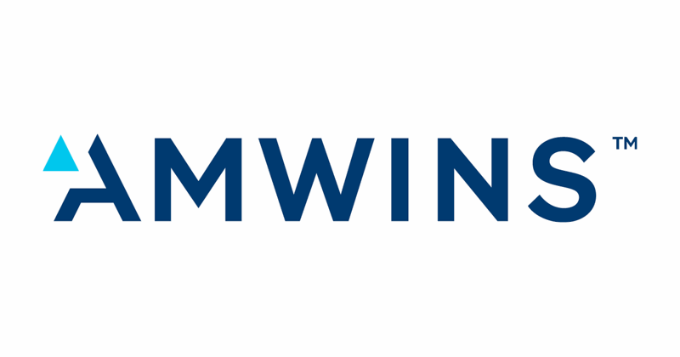

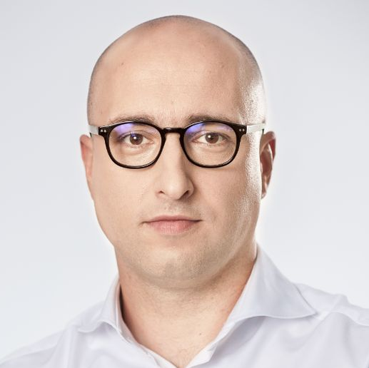




MJM HOLDINGS
Company Overview
COMPANY OVERVIEW
FINANCIAL PERFORMANCE (PLNmm)
MJM Holdings (“MJM” or the “Company”) is a leading Polish commercial lines insurance broker, founded in 2017 and now the #[6] broker in Poland (behind large international players such as Marsh, WTW and Aon) as well as the #[2] independent broker
MJM is comprised of 5 divisions focusing on P&C, Reinsurance, Commercial Motor, MGA and Group Life insurance
  MJM has been a highly successful consolidator in the market, acquiring Attis Brokers (P&C) and Smartt Re (Reinsurance) in 2018 and 2021 respectively
  Under Corsair’s ownership, Leadenhall (MGA, 2024), GIA Investments (Group Life, 2025), Certo (Group Life and Health Insurance, 2026) and Maximus Broker (Municipalities and Local Government, 2026) were also acquired
The Company has compelling financial performance with 28% organic growth historically (2020-2025) and an average 28% EBITDA margin over the same period
MANAGEMENT TEAM
BUSINESS MIX
 | Marcin Ślotała Founder & Group CEO | Marcin Ślotała is the CEO and founder of MJM, having started the business as a de novo commercial motor insurance broker in 2017 Prior to MJM, Mr. Ślotała founded MAK Group in 2003, which is currently the largest independent broker in Poland
 | Michal Chmielewski Vice President | Michał Chmielewski is the Vice President of MJM Group and a management board member Mr. Chmielewski was formerly the CEO and co-founder of Smartt, prior to its acquisition by MJM Holdings, and was formerly head of AmWINS Poland
 | Grzegorz Kruk CFO and Head of M&A | Grzegorz Kruk is Chief Financial Officer and Head of M&A of MJM Group Prior to MJM, Mr. Kruk was formerly an investment banking and M&A executive at UniCredit / Pekao Investment Banking, Wood & Co, and Wirtualna Polska Group
KC reverting on the split for Maximus between life and non-life
Total Sep-26 LTM Revenue:
PLN 320.9 (€73.3mm)
(1) Excludes MGA. PLN USD FX Rate as at 26 October 2026 of 0.2283.
5

Slide 6

MJM HOLDINGS
TG TBU
Key Investment Highlights
1
Leading independent broker consolidator operating in a fragmented market
#[2] Independent Polish Insurance Broker that has scaled rapidly since inception in 2017 and operates in a highly fragmented market with over 1,400 brokers, many of which remain founder-owned
#2
Independent Polish Broker
2
Compelling growth dynamics in the Polish Market across GDP and insurance distribution
Non-life commercial insurance market in Poland estimated to be ~PLN26bn, growing at ~9-10% from 2022-27 with the market and broker channel benefitting from increasing penetration as well as overall Polish GDP growth
9-10%
Broker Market Growth 2022-2027
3
Demonstrated track record of successful M&A execution
4 acquisitions completed since inception driving strong growth and value creation. Extensive pipeline of over 140 targets identified and additional M&A opportunities beyond bolt-on domestic acquisitions
4
Acquisitions To Date
4
Diversified business model across products and end markets
MJM is well diversified from both a product and end-market perspective covering commercial motor insurance, P&C across a wide range of end markets including public sector clients, reinsurance, MGA and Group Life insurance capabilities
[1,700]+
Client Accounts
5
Leading platform operating in attractive niches
Presence in niche and specialty lines that are complex for clients drives higher commission rates and captures a greater part of the insurance value chain
#1
in P&C MGA, Group Life and Reinsurance
6
Strong organic growth driven by salesforce effectiveness and synergies
Historic organic growth driven by market share gains and business growth with existing clients. Future growth complemented by the development of new capacity, such as the MGA platform, and product lines such as group life
28%
Organic Rev. Growth 2020-2025
7
Highly attractive and scalable financial profile
Focus on higher margin business with corporate clients driving recurring predictable growth
29%
Adj. EBITDA Margin 2025A
Source: Company Information, Oliver Wyman.

Slide 7






MJM HOLDINGS
CEE consolidation narrative for new investors?
MJM’s Journey
INCEPTION
CORSAIR OWNERSHIP
THE FUTURE
Launched as a de novo insurance broker platform with a focus on commercial motor insurance brokerage supported by the acquisitions of Attis Brokers and Smartt Re securing P&C and reinsurance capabilities
Continued strong organic growth and market share gains supported by acquisitions and the establishment of an MGA strategy to add local market capacity for international carriers and capture a larger share of the insurance value chain
Establish MJM as the leading independent domestic broker and [potential CEE consolidation story]
Acquisitions
2
(Attis and Smartt Re)
4
(Leadenhall, GIA Investments, Certo and Maximus Broker)
140+
(Targets in M&A Pipeline)
MJM’s Next Growth Phase
FY28
Targets
PLN700mm+
Revenue
PLN200mm
EBITDA
Solutions Offered
Revenue (FY22): PLN 76mm
EBITDA (FY22): PLN 22 mm
Revenue (FY25): PLN 216mm⁽¹⁾ (42% FY22-25 CAGR)
EBITDA (FY25): PLN 76mm⁽¹⁾ (51% FY22-25 CAGR)
Motor
P&C
Reinsurance
MGA
Group Life
Municipalities
Continued growth in new and existing product lines
Further penetration of the existing customer base
#1 independent player in Poland, growing presence in CEE
Built out MGA Division to source and provide external risk capacity
Full M&A team completing acquisitions with EBITDA of PLN20mm+ each year
Acquisition of Leadenhall to accelerate the MGA Strategy
Acquisition of Certo Broker
Founding of MJM and launch of motor insurance
Acquisition of GIA Investments to establish the Group Life division
Acquisition of Maximus Broker, a leading public sector broker
Acquisition of Attis Brokers
Corsair acquires majority stake in MJM
Acquisition of Smartt Re
2017
2018
2021
2024
2025
2026
2028+
Revenue
PLNmm
~30
~55
~120
~320⁽¹⁾
700+⁽¹⁾
(1) Sep-26 LTM 2026. Includes contribution of acquisitions.

Slide 8








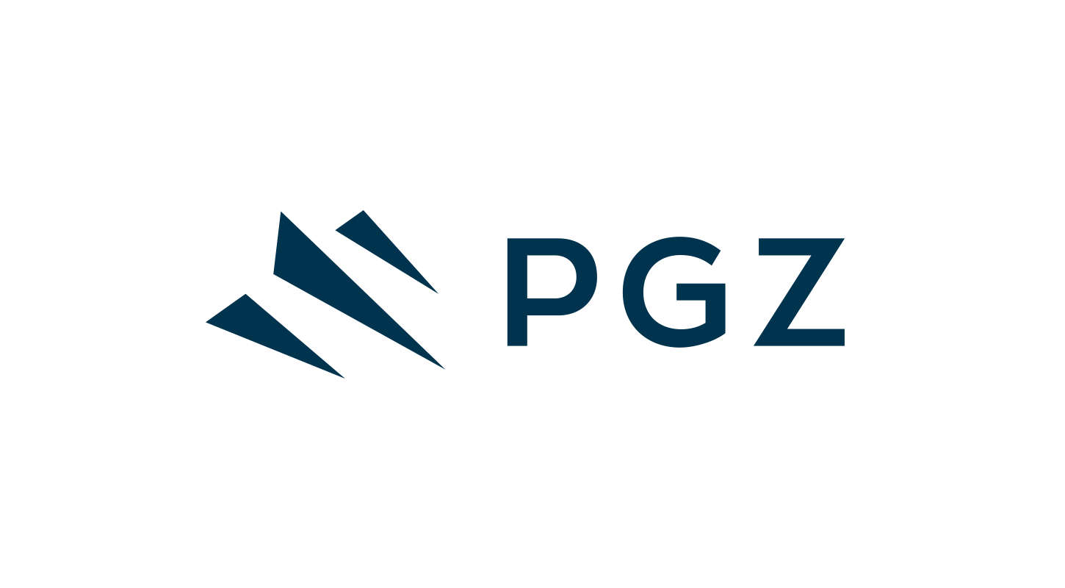



MJM HOLDINGS
KC reverting on the split for Maximus between life and non-life
Overview of MJM’s Product Offering
 | P&C | MGA | Group Life Insurance | Reinsurance | Motor Insurance
LAUNCHED / ACQUIRED | 2020 (Attis Brokers) | 2024 (Leadenhall) | 2025 (GIA Investments) | 2021 (Smartt Re) | 2017 (MJM Brokers)
REVENUE Sep-26 LTM (PLNmm) | 83 | 53 | 100 | 49 | 35
DESCRIPTION | Offers P&C insurance and employee benefits management across a variety of commercial lines in Poland, with reinsurance broking also offered The division targets local corporate clients, and can broker insurance for property risks, cyber risks, marine risks, construction risks, and business liability | Leading tech-enabled MGA Capacity agreements with Lloyds and others carriers to support underwriting Strong positions in highly attractive niches that enable it to act as an alternative source of risk capacity to both incumbent carriers and new carriers looking to establish a market presence | Offers insurance, reinsurance and agency functions 10th largest insurance broker operating in Poland Market leader in group life insurance serving SME’s and self-employed | Largest reinsurance broker in Poland, with a larger market share than Marsh, Willis Towers Watson, and Aon combined Specializes in facultative reinsurance and is active in the international market, with a strong position in reinsurance for specialty risks | Offers motor insurance for commercial clients The division typically targets car dealers, fleets, and leasing companies as clients Includes some claims management and risk management capabilities
SEGMENTS SERVED | Natural Resources Engineering & construction Financial Institutions Marine Energy Aviation | Personal Accident Professional Indemnity Directors & Officers Life Insurance P&C Marine Surety (launching Q3 2025) | Group Life Assistance Property Communications Transport | Energy and chemistry Aviation and space Maritime Financial risks Property risks Cyber risks | Car dealers Car rental and fleet management Fleets – passenger and trucks Leasing companies
MARQUEE CLIENTS |  | c.25k policyholders⁽²⁾ | c.260k policyholders⁽²⁾
26 %
17%
31%
15%
11%
Management Plan.
Company Information.
8
% of Sep-26 LTM Revenues

Slide 9
MJM HOLDINGS
TBU – anonymize + update commentary
M&A Update
ACTIVE M&A PIPELINE
COMMENTARY
Company |  | Sub-Verticals | FY25 |  |  | Target Signing
 |  |  | GWP (PLN mm) | Revenue (PLN mm) | EBITDA (PLN mm)
1 | Unity | Trade Credit | 78.0 | 11.2 | 5.2 | H1 27
2 | Invictus Broker | Master in guarantees niche, strong growth | 37.0 | 10.8 | 5.0 | H1 27
3 | Inter Broker | Public tenders’ know-how, Diversified clients | 141.0 | 23.0 | 7.0 | H1 27
4 | IFB Broker | Business Clients | 30.0 | 5.0 | 3.5 | H2 2027
5 | JSU (Agent) | Add-on to GSU Polisa | n/a | 16.5 | 3.3 | H2 2027
6 | Gardia Broker | Add-on to GIA Group | n/a | 3.6 | 0.7 | H2 2027
7 | RKB | Diversified | 100.0 | 11.9 | 2.4 | From 2028
8 | Infinity Broker | Niche broker, focus on IT and construction | n/a | 7.5 | 5.1 | From 2028
9 | CE Broker | Focus on guarantees | 32.0 | 4.1 | 0.8 | From 2028
10 | KJF Broker | Diversified client portfolio (except 1 client) | 60.0 | 7.7 | 4.0 | From 2028
Extensive Proprietary Pipeline
MJM has identified over 140 potential targets in the Polish brokerage market. The ten shown opposite are actionable in the near term and represent c.PLN 101mm of revenue and c.PLN 37mm of EBITDA (FY25)
The three high-conviction targets (c.PLN 45mm revenue, c.PLN 17mm EBITDA) are in active bilateral dialogue, with signing targeted for H1 2027. Sourcing relies on founder relationships rather than auctions
Update on Pipeline
Since his appointment in April 2024, the Head of M&A (promoted to CFO in Jan-26) (Greg Kruk) and M&A Director, Krystian Czupryniak, have performed well in their role in building out the M&A pipeline and identifying over 140 targets of which 50 have been contacted (see RHS for top targets)
The vast majority of targets have been sourced through MJM’s own network
Contacted targets are receptive to MJM’s position as the leading alternative to being acquired by a large international player
Most targets are open to M&A discussions, although the level of sophistication and understanding of M&A processes is limited in the market
In addition, the lack of scale among smaller targets has led to delays in information provision and commencement of diligence
The acquisitions being evaluated remain financially accretive with post-synergy multiples below Corsair’s entry acquisition multiple of 12.0x
Learnings To-Date
Initial feedback from contacted targets shows an openness to a sale to MJM, especially versus other consolidators such as PIB (Apax-owned) or Acrisure (backed by ADIA)
Sophistication of sellers is low, and targets typically require some education on the merits of receiving shares in the group and working with a Private Equity sponsor as opposed to a full cash exit
Potential transactions have typically followed a “barbell” structure with a handful of large potential assets and a large number of smaller opportunities
Specialty and Niche Capabilities
The pipeline is weighted towards specialist sub-verticals, including trade credit, guarantees, public tenders, construction and IT, alongside Group Life add-ons. These lines typically carry higher commission rates
Each target is expected to bring MJM a new product capability or client segment rather than scale alone. Expansion into neighbouring CEE markets represents potential upside beyond the current pipeline
Acquisition Rationale and Value-Add
Acquired brokers retain their brand and leadership while gaining access to MJM’s central service layer (finance, HR, compliance, IT and M&A), the group’s carrier relationships and cross-selling across P&C, reinsurance, group life, motor and MGA capacity via Leadenhall
This playbook has been applied across six acquisitions since 2017, including four under Corsair’s ownership, each adding a new division or capability
Disciplined Pricing at Attractive Entry Multiples
Bolt-ons are targeted at [x]x–[x]x FY25 EBITDA pre-synergies, versus 13.2x headline (10.2x post synergies) for Maximus Broker, a European precedent median of 17.3x (2021-26) and listed brokers at c.14-16x 2026E
Bilateral sourcing supports pricing discipline, with earn-outs tied to delivered EBITDA and part-funding through MJM’s committed acquisition facility
Complementary Team Lift Channel
Alongside M&A, MJM recruits producer teams from competitors, bringing clients and specialist expertise onto the platform at minimal upfront cost, as with a recent senior sales hire from a leading domestic broker into Attis
Management monitors top producers at the Big 3 and larger domestic brokers and holds a shortlist of three to five teams. This channel sits outside the base case and is upside to plan
Source: Company information, Polish Broker Almanac, Corsair analysis.
High Conviction FY27 M&A Targets
9

Slide 10
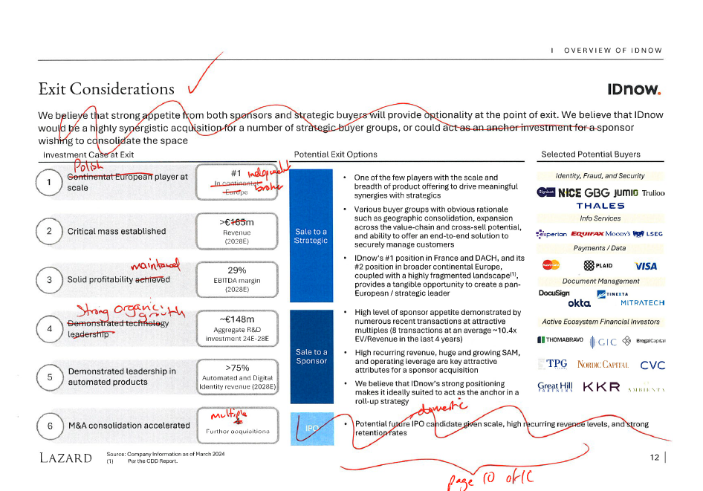

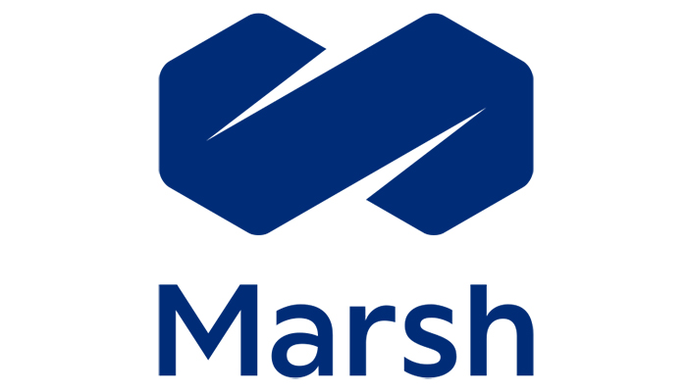




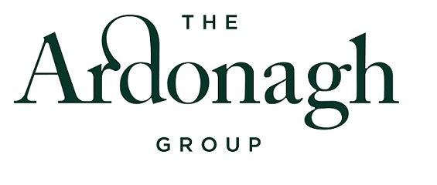


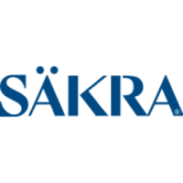









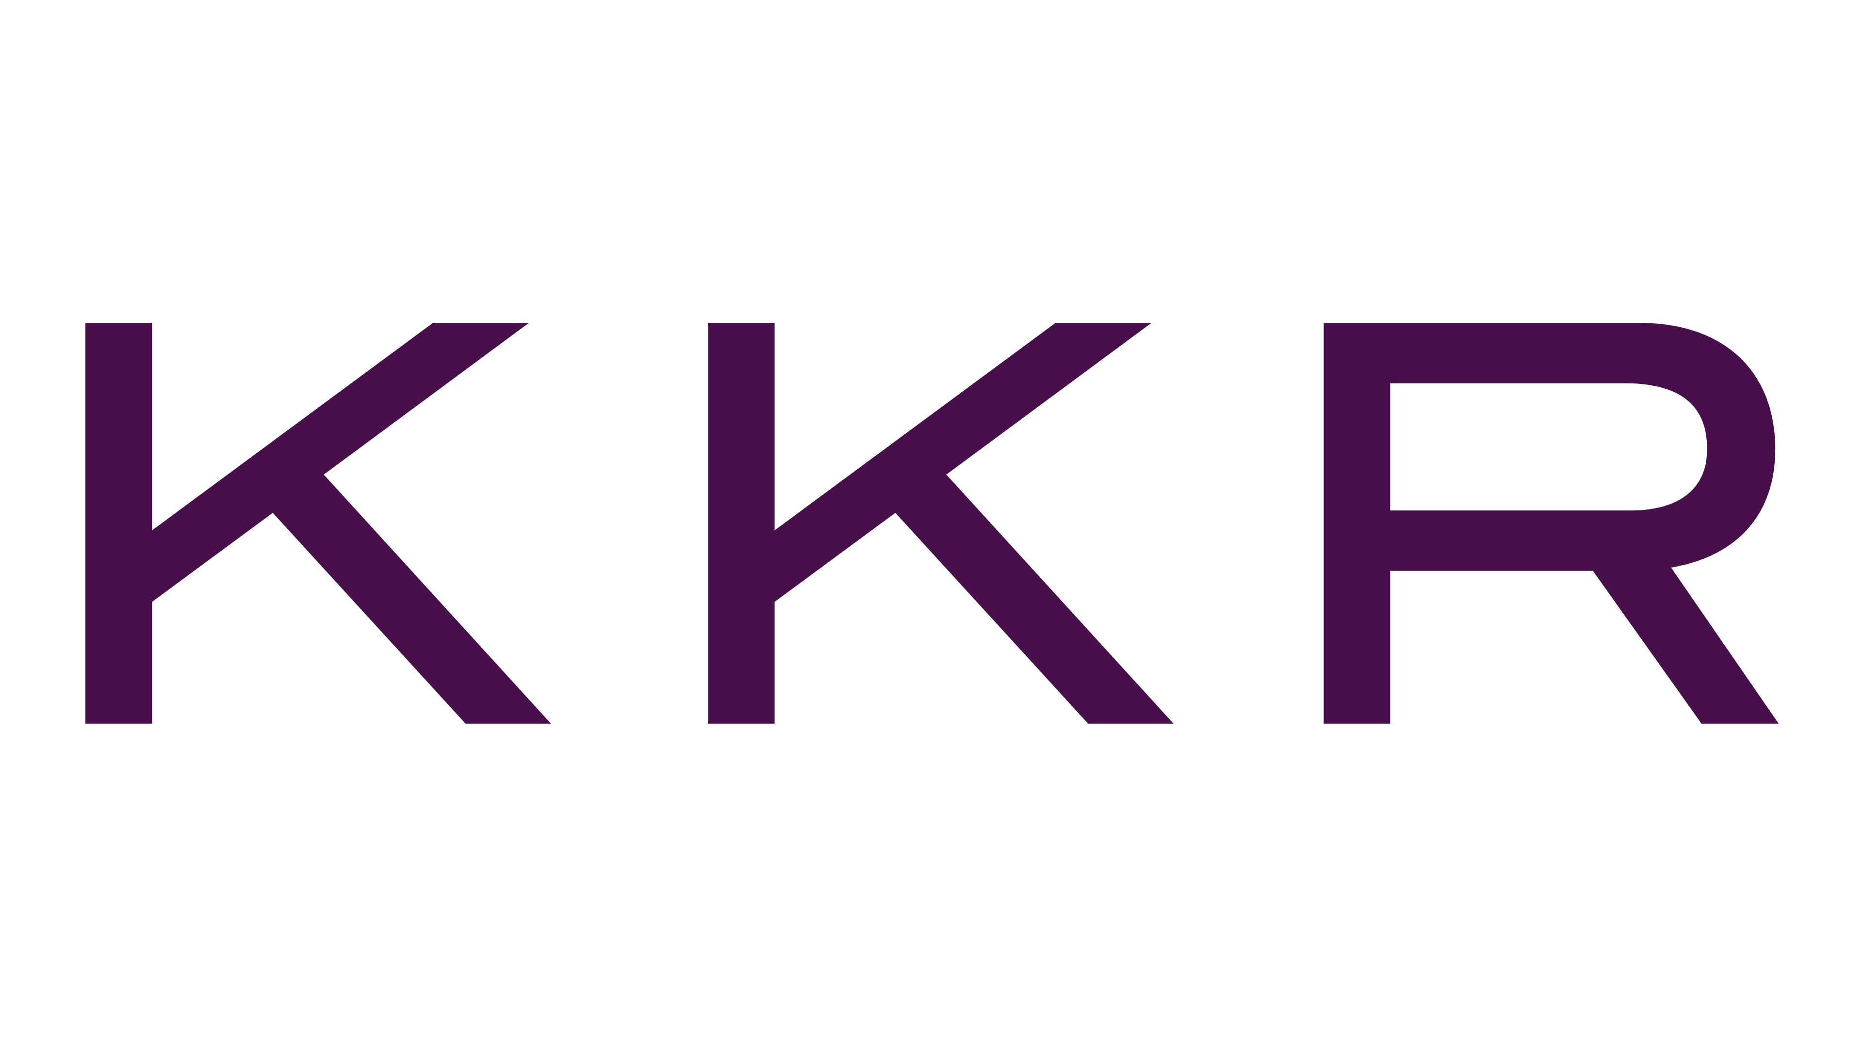






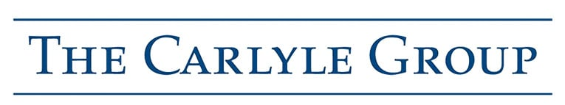

MJM HOLDINGS
TG – check numbers
Exit Considerations
INVESTMENT CASE AT EXIT
POTENTIAL EXIT OPTIONS
SELECTED POTENTIAL BUYERS
Polish player at scale
Sale to a Strategic
A variety of strategic investors are expected to be highly interested in acquiring MJM
MJM could be attractive to bolster corporate presence in Poland for the Big 3 brokers, who are typically more selective and look for strategic fit and large enterprise clients (with an aversion to personal lines)
For PE-backed consolidators, MJM would be a unique opportunity to acquire a leadership position in the Polish market and complement European coverage
Acquisition by Other International Consolidators is likely to be opportunistic and to improve share of direct business
Big 3 International Buyers
1
#1
Independent broker
TV: see comments on the next page for the logos
Critical mass established
PE Backed Consolidators
2
PLN700mm+
Revenue
(2028E)
Solid profitability maintained
3
c.30%+
EBITDA margin
(2028E)
International Consolidators
Strong organic growth
Sale to a Sponsor
Sponsors have shown strong interest in the insurance brokerage space in Europe
International sponsors have been actively acquiring Polish businesses and a range of PE backed broker consolidators are also active in the market
MJM would represent an ideal platform for financial sponsors to successfully consolidate the European / CEE insurance broker market
Asset will likely be too large for domestic PE funds at exit and attract the most interest from international financial sponsors
4
28%
Organic EBITDA CAGR (FY25-28)
Other Consolidators
Vertically integrated MGA platform
5
PLN c.30mm
MGA EBITDA
(2028E)
International PE Funds
M&A consolidation accelerated
6
Multiple
further acquisitions
Source: Company information as of June 2025.

Slide 11
Polish Insurance Distribution Market

Slide 12
MJM HOLDINGS
TV: TBU pending CDD
Market Overview
POLISH GDP (€bn)
KEY MARKET TRENDS
POSITIONING
1
Shift from direct insurance distribution to third-party specialists driven by increasingly complex client demands
Vertical integration, product diversification and coverage of specialty lines make MJM a sophisticated partner and well positioned to meet client requirements
2
Under penetration for non-life insurance in Poland and increasing penetration by brokers in distribution provides headroom for future growth
#6 broker in Poland with strong organic growth and M&A pipeline to materially enhance the profile of MJM and maximise growth
POLISH NON-LIFE INSURANCE BROKERAGE GWP OVER TIME (PLN bn)
Total
Broker Market Penetration
16%
23%
25%
3
Personal
3%
4%
4%
International carriers continue to use MGAs for specialty and niche risks and to access geographies
Through Leadenhall, MJM is now one of the largest MGAs in Eastern Europe with secured capacity from leading international carriers
Commercial
31%
37%
39%
CAGR: 9%
‘17-’24
CAGR:
’24-’26
CAGR: 11%
8%
0%
4
12%
11%
Commission rates for commercial P&C average c.18% but differ substantially by business lines
MJM has diversified away from lower commission lines and captures a larger part of the distribution value chain
Source: NBP, IMF, Eurostat, KNF, Polish Chamber of Insurance, The World Bank, Oliver Wyman, Polish Financial Supervision Authority (KNF).

Slide 13
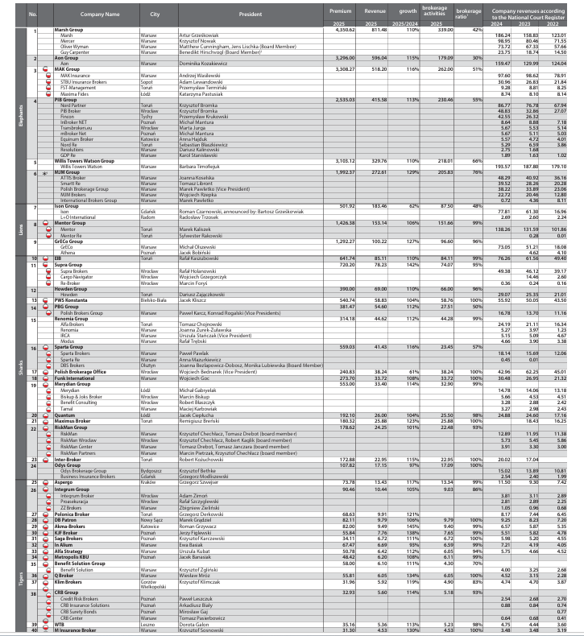









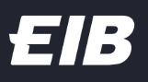


MJM HOLDINGS
TG: what is Fincon?
Check numbers vs. Almanach
Overview of Players Active in Polish Insurance Brokerage
TOP 20 PLAYERS IN POLISH INSURANCE BROKERAGE
POLISH INSURANCE BROKER ARCHETYPES
Ranking | Local | Company Name | Premium 2025 (PLNmm) | Revenue 2025 (PLNmm)
1 |  | Marsh Group | 4,350.6 | 811.5
2 |  | MAK Group | 3,308.3 | 518.2
3 |  | Aon Group | 3,296.0 | 596.0
4 |  | Willis Towers Watson Group | 3,103.1 | 329.8
5 |  | PIB Group | 2,535.0 | 415.4
6 |  | MJM Group | 2,172.7 | 298.5
7 |  | Mentor Group | 1,426.4 | 153.1
8 |  | GrECo Group | 1,292.3 | 100.2
9 |  | Supra Group | 720.2 | 78.2
10 |  | EIB | 641.7 | 85.1
11 |  | Sparta Group | 559.0 | 41.5
12 |  | Merydian Group | 553.0 | 33.4
13 |  | PWS Konstanta | 544.7 | 58.8
14 |  | Ison Group | 501.9 | 183.5
15 |  | Howden Group | 390.0 | 69.0
16 |  | PBG Group | 381.5 | 54.6
17 |  | Hensinia Group | 314.2 | 44.6
18 |  | Funk International | 273.7 | 33.7
19 |  | Polish Brokerage Office | 240.8 | 38.2
20 |  | Quantum | 192.1 | 26.0
Big 3 International Brokers
3 players
PLN1.5-2.5bn GWP per player
PE-Backed Consolidators
4 players
PLN500mm-1bn GWP per player
Serves US / European enterprises and large domestic corporates / SoEs
Non-life focus; trade credit, financial lines and W&I capabilities
Some MJM overlap, e.g. Marsh’s Toyota motor business
TG: what is Fincon?
Check numbers vs. Almanach
Often serves both consumers and businesses
Mix reflects acquisitions, often with personal lines / agency business
Acrisure is mainly agency, with a smaller brokerage presence
Large & Medium Domestic
Players
5 players
PLN500mm-2bn GWP per player
Long Tail of Smaller Domestic
Operators
~1,400 players
PLN0-500mm GWP per player
Local consolidators serving large / mid-sized corporates, plus agency / consumer lines
Key MJM competitors: MAK (Motor, industry); Mentor (industry)
National / regional mix; less reinsurance than MJM
Smaller, often regional specialists
Bulk of base-case M&A opportunity in Poland
Note this excludes the agency channel that focuses on personal lines
+ additional names in longer tail
Source: Corsair analysis, Polish Brokers Almanac.

Slide 14
MJM Financial Profile

Slide 15
MJM HOLDINGS
Financial Performance and Business Plan
PRO-FORMA REVENUE 2022A-2029E (PLNmm)
COMMENTARY
Organic Growth
xx
23.8%
8.4%
51.7%
30.4%
15.8%
15.1%
TG to write commentary
PRO-FORMA EBITDA & EBITDA MARGIN 2022A-2029E (PLNmm)
Adj. EBITDA Margin ex. MGA
30.8%
30.1%
33.7%
31.6%
30.2%
29.5%
28.5%
27.8%
Source: Company information, Corsair analysis.
Note: MJM Organic, GIA, Leadenhall, MJM MGA and Certo based on Corsair’s Base Case from 2027 onwards. Remainder of 2026 M&A pipeline includes Invictus, Arcun, IFB Brokers and Unity. Additional M&A includes Corsair’s Base Case M&A projections for FY27-FY28.

Slide 16
MJM HOLDINGS
Varak to update to September once ready
Align to FDD
May 2026 YTD Trading
MJM delivered +28.6% YoY Revenue driven by strong growth in Group Life and MGA, while Adj. EBITDA grew +23.3% YoY
YTD May 2026 (December Y/E, PLNmm)
Financial Review
 | 2026A | 2026B | 2025A | ∆ vs. 2026B | ∆ vs. 2025A | LTM
Revenue
Motor | 13.0 | 19.4 | 9.3 | (32.8)% | +39.9% | 30.1
P&C | 24.1 | 32.3 | 24.2 | (25.3)% | (0.3)% | 55.8
Reinsurance | 17.6 | 18.1 | 15.8 | (2.7)% | +11.8% | 49.4
MGA | 21.7 | 24.7 | 17.8 | (12.1)% | +21.8% | 48.9
Group Life | 42.3 | 40.1 | 25.2 | +5.4% | +67.6% | 77.5
Total Revenue | 118.7 | 134.6 | 92.3 | (11.8)% | +28.6% | 261.7
Gross Profit | 83.3 | 94.9 | 63.3 | (12.3)% | +31.6% | 189.0
% Margin | 70.1% | 70.5% | 68.5% |  |  | 72.2%
Adj. EBITDA | 27.9 | 32.7 | 22.7 | (14.6)% | +23.3% | 76.1
% Margin | 23.5% | 24.3% | 24.6% |  |  | 29.1%
MJM has grown strongly vs. May-25 YTD, with ~30% Revenue and Gross Profit growth and ~23% Adj. EBITDA growth
Total Revenue grew to PLN 118.7mm in May-26 YTD, vs. May-25 YTD (+28.6%), driven by strong growth in Group Life (+67.6% YoY) and Motor (+39.9%) and continued growth in MGA (+21.8%) and Reinsurance (+11.8%)
Gross Profit reached PLN 83.3mm (+31.6% vs. May-25 YTD) at a 70.1% margin, slightly ahead of May-25 YTD (68.5%)
Adj. EBITDA reached PLN 27.9mm (+23.3% vs. May-25 YTD) at 23.5% margin vs. 24.6% at May-25 YTD
Underperformance vs. FY26 budget driven primarily by losses in the P&C and reinsurance divisions, delayed contracts, partially offset by Group Life outperformance
Source: Company information.

Slide 17
MJM HOLDINGS
TBU
Show Total Returns – sensi on 2028 and 2029 exit
Include Net Returns
M&A & Secondary Returns Outlook and Sensitivities
TRANSACTION TERMS
SUMMARY USD IRR / MOIC RETURNS
Entry and Exit:
Entry assumed in October 2026 with a total enterprise value of PLN 294mm⁽¹⁾ with exit expected in 2028 in-line with underwriting case
Maximus entry valuation equal to PLN 126mm based on 13.2x 2025A Adjusted EBITDA of PLN 9.5mm (PLN 113mm upfront at 11.8x and 10.2x post synergies of PLN 1.5mm)
Transaction Structure:
Total cash consideration of PLN 249mm paid upfront to Certo (PLN 11mm), Maximus (PLN 113mm), IFB Brokers (PLN 32mm) and Unity Broker (PLN 62mm), with Invictus paid total cash consideration of PLN 32mm and PLN 32mm in MJM stock
Results in New Money shareholders holding c.15% of preferred shares and c.10% of ordinary shares on day 1
Debt financing:
Maximus transaction to be partly debt financed via a PLN 24mm committed acquisition facility and predominantly equity financed (PLN 94mm / $25mm) with PLN 14mm in earnouts tied to FY26E Adj. EBITDA performance
Other FY26 transactions to be partly debt financed by PLN 95mm increase in MJM’s senior debt facility provided by Eurazeo
Other Considerations:
Team is currently engaging with the target businesses in order to reach agreement on synergy potential and assist with implementation of some initiatives to achieve synergies
Corsair / MJM Base Case Returns, Assuming Exit in 2027
(2)
Corsair / MJM Base Case Returns, Assuming Exit in 2028
(2)
SOURCES AND USES
Corsair / MJM Base Case Returns, Assuming Exit in 2029
Cut the level of detail down – investors POV on the S&U (not the deal S&U)
(2)
Source: Company information, Corsair analysis.
Note: USDPLN rate of 3.772 as of 25 June 2026. Exit USD returns assume a constant FX rate. The acquisition of the stake held by Dariusz and Iwona Pokrowska is excluded from returns calculations given the price is not agreed.
(1) Includes Total Certo Enterprise Value (PLN 11mm), Maximus Enterprise Value (PLN 126mm), Invictus Enterprise Value (PLN 64mm), IFB Brokers Enterprise Value (PLN 32mm) and Unity Broker Enterprise Value (PLN 62mm).
(2) Includes equity for the secondary purchase.

Slide 18
Appendix

Slide 19
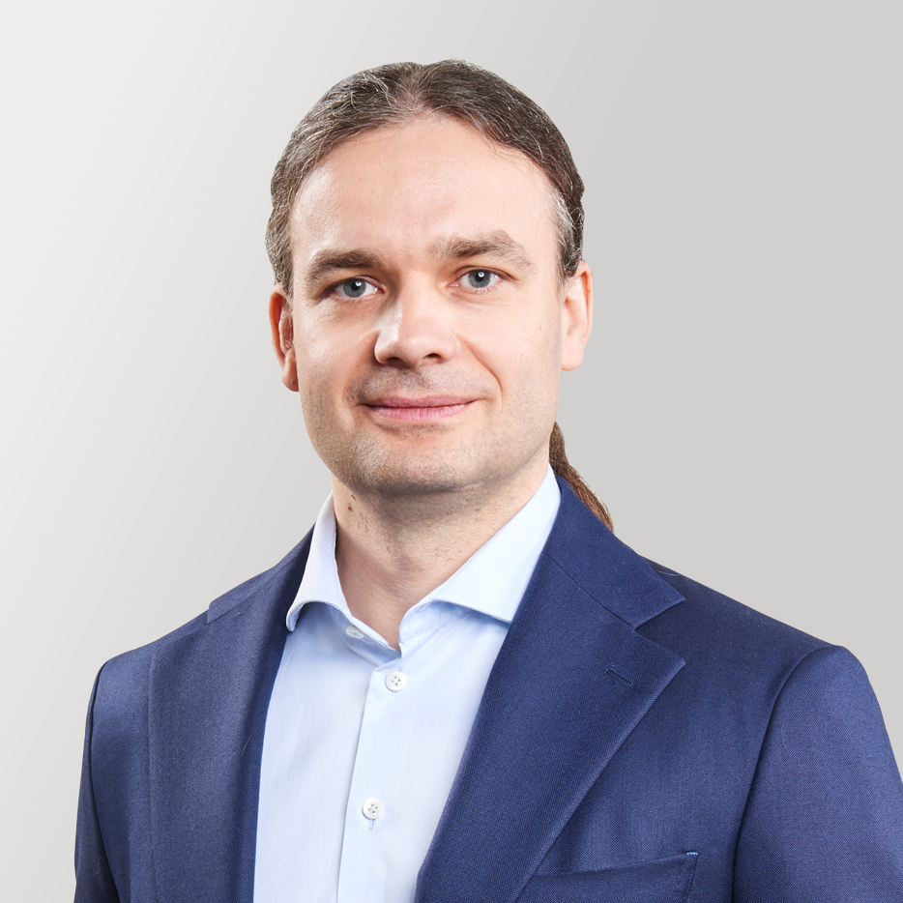
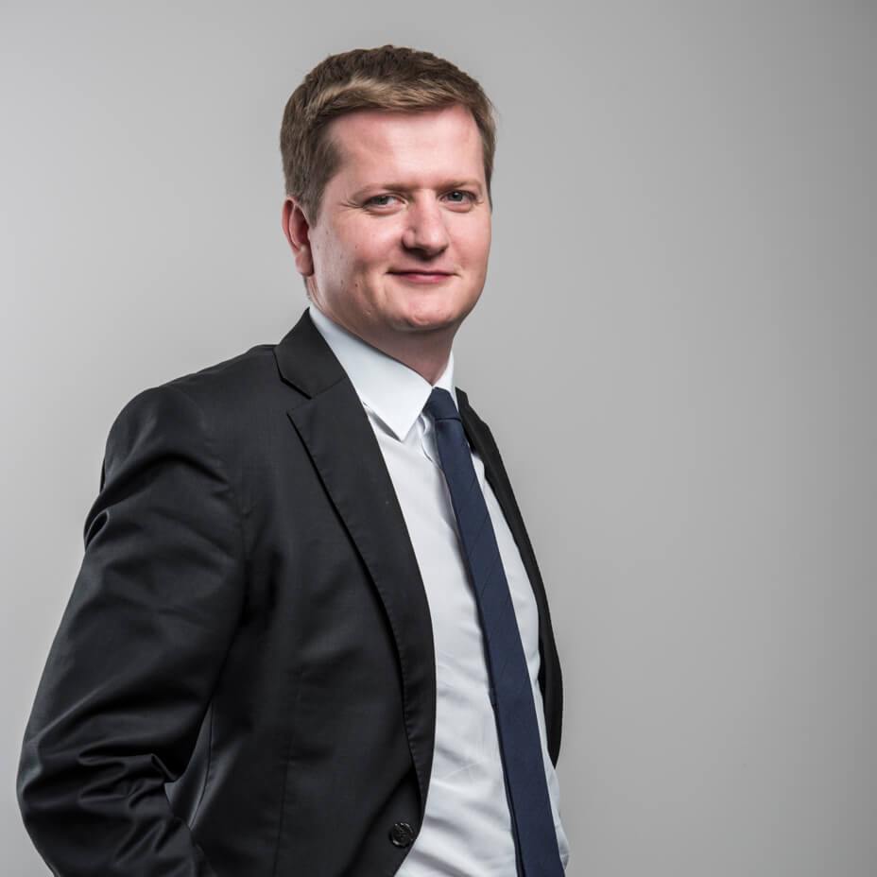
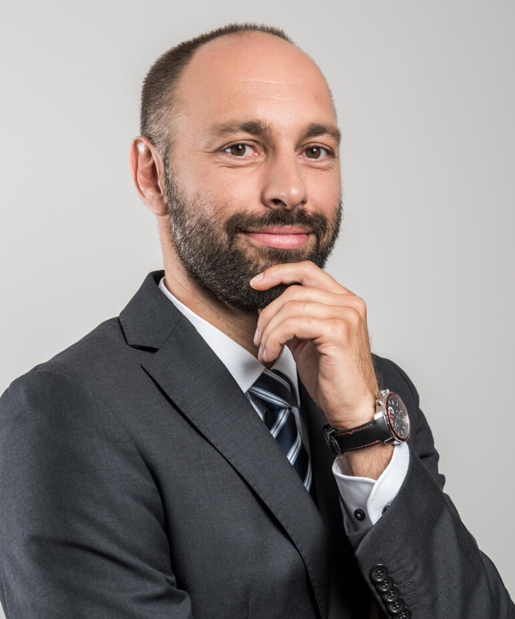
MJM HOLDINGS
Unity Brokerage Group Company Overview
COMPANY OVERVIEW
KEY FINANCIALS (PLNmm)
Unity Brokerage Group is a leading Polish insurance broker specializing in trade credit insurance for domestic and international corporate clients
Headquartered in Poznań, the Group operates nationwide through Unity Trade Credit Broker and its North, South and East regional companies
Unity Trade provides receivables insurance; the independently operated Unity Broker offers property insurance, surety bonds and cover for other risks
The Group has a diversified, loyal client base spanning fuel, pharmaceuticals, food production and other industries
Unity Trade’s operating model combines four core functions:
  Sales: Experienced brokers acquire new clients nationwide; the existing Unity Trade client base supports cross-selling by Unity Broker
  Administration: Clients receive support from a lead broker and administrative broker, with quarterly policy reports
  Risk Assessment: Supports credit-limit negotiations and advises on increasing available limits
  Claims: Assists with documentation, insurer communication and denied-claims disputes
Customized Zoho CRM supports Unity Trade’s processes; the Group plans CEE expansion through offices, acquisitions and specialist recruitment
Forecast based on Unity Brokers Management Plan
KEY MANAGERS
Sales Structure (2025)
Bartosz Dobecki, Group CEO and Co-owner
Founder and Chairman of Unity Group; insurance broker and former Euler Hermes executive
Oversees sales, insurance placement and negotiations with major corporate clients
Unity Trade: 2025 Revenue structure by Insurer
Unity Broker: 2025 Revenue structure by Insurer
Damian Brzozowski, Vice President and Co-owner of Unity Broker
Founder and partner with corporate risk-management and insurance brokerage experience
Develops domestic and international insurance programs and oversees corporate client relationships
Łukasz Barański, Board Member and Co-owner of Unity Trade Credit Broker
Insurance broker; formerly Deputy Director of Euler Hermes’ Poznań branch
Developed Euler Hermes’ Wrocław operations and previously led KUKE’s Wrocław regional office
Source: Unity IM (overview, managers and sales); Company information, Maximus Broker IM, Corsair analysis (key financials).

Slide 20

MJM HOLDINGS
Invictus Broker Company Overview
COMPANY OVERVIEW
KEY FINANCIALS (PLNmm)
Invictus Broker is a Polish insurance brokerage specializing in financial guarantees and contract insurance for corporate investment projects
Registered in 2016 and based in Warsaw, the company was established by Marta Gładosz, its founder and CEO
Clients operate across construction, infrastructure, railways and energy, including renewable-energy investment projects
The business manages large financial-guarantee portfolios and combines brokerage with strategic and transaction-related advice
Client support covers the investment lifecycle, from planning and tender participation through contract execution and warranty obligations
The company reviews investor contracts and recommends changes to financial-guarantee and insurance provisions during negotiations
Invictus arranges guarantee funding and contract insurance for projects in Poland and abroad, including requirements of foreign investors and financial institutions
The specialist team draws on experience in insurance, brokerage, guarantees, underwriting, claims and public procurement
Forecast based on Maximus Management Plan
KEY MANAGERS
Sales Structure
Marta Gładosz, Founder and CEO
Established Invictus Broker on the basis of her experience managing large financial-guarantee portfolios
20 years of financial-guarantee experience reported in the 2025 company profile
Experience in the insurance industry underpins relationships with guarantee providers in the Polish market
Heads a specialist brokerage focused on arranging financial guarantees and supporting corporate investment projects
Supported by professionals with insurance-company and brokerage backgrounds in guarantees, underwriting and claims
The team also includes public-sector investment and procurement expertise
Products & Services
Client Segments
Financial guarantees and guarantee-portfolio management
Contract insurance for projects in Poland and overseas
Advisory from tender preparation to execution and warranty obligations
Review and negotiation of guarantee and insurance clauses
Construction and infrastructure contractors
Railway and energy-sector project companies
Renewable energy, including solar, wind and alternative-energy projects
Residential, industrial and public-utility construction projects
Source: Invictus company profiles (Forbes 2024; Forbes 2025); Polish KRS / Rejestr.io; Maximus Broker IM, Corsair analysis (financials).

Slide 21
MJM HOLDINGS
TBU – need some actual data for now
Inter Broker Company Overview
COMPANY OVERVIEW
KEY FINANCIALS (PLNmm)
Invictus Broker is a Polish insurance brokerage specializing in financial guarantees and contract insurance for corporate investment projects
Registered in 2016 and based in Warsaw, the company was established by Marta Gładosz, its founder and CEO
Clients operate across construction, infrastructure, railways and energy, including renewable-energy investment projects
The business manages large financial-guarantee portfolios and combines brokerage with strategic and transaction-related advice
Client support covers the investment lifecycle, from planning and tender participation through contract execution and warranty obligations
The company reviews investor contracts and recommends changes to financial-guarantee and insurance provisions during negotiations
Invictus arranges guarantee funding and contract insurance for projects in Poland and abroad, including requirements of foreign investors and financial institutions
The specialist team draws on experience in insurance, brokerage, guarantees, underwriting, claims and public procurement
Forecast based on Maximus Management Plan
KEY MANAGERS
Sales Structure
Marta Gładosz, Founder and CEO
Established Invictus Broker on the basis of her experience managing large financial-guarantee portfolios
20 years of financial-guarantee experience reported in the 2025 company profile
Experience in the insurance industry underpins relationships with guarantee providers in the Polish market
Heads a specialist brokerage focused on arranging financial guarantees and supporting corporate investment projects
Supported by professionals with insurance-company and brokerage backgrounds in guarantees, underwriting and claims
The team also includes public-sector investment and procurement expertise
Products & Services
Client Segments
Financial guarantees and guarantee-portfolio management
Contract insurance for projects in Poland and overseas
Advisory from tender preparation to execution and warranty obligations
Review and negotiation of guarantee and insurance clauses
Construction and infrastructure contractors
Railway and energy-sector project companies
Renewable energy, including solar, wind and alternative-energy projects
Residential, industrial and public-utility construction projects
Source: Invictus company profiles (Forbes 2024; Forbes 2025); Polish KRS / Rejestr.io; Maximus Broker IM, Corsair analysis (financials).

Slide 22











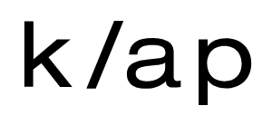




















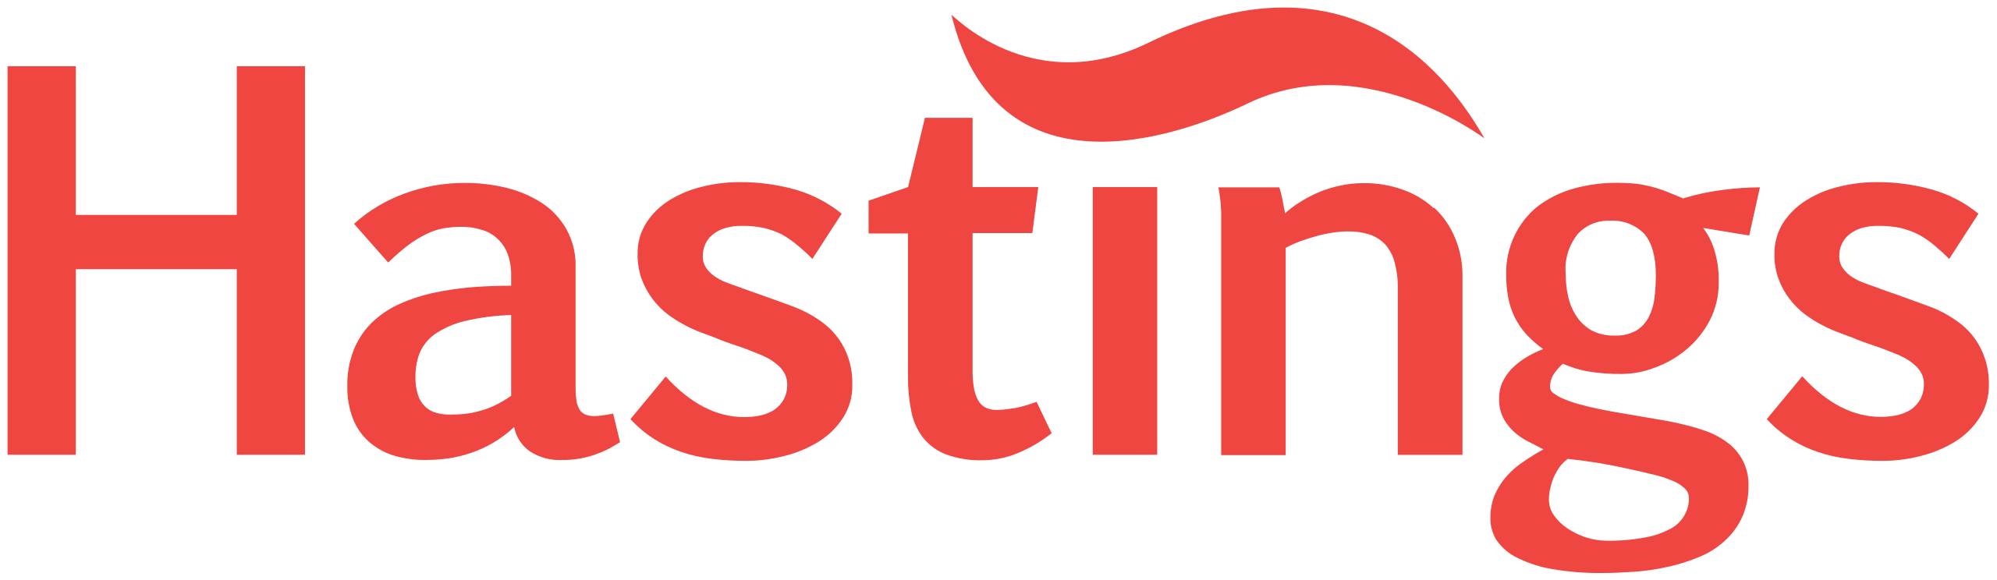





















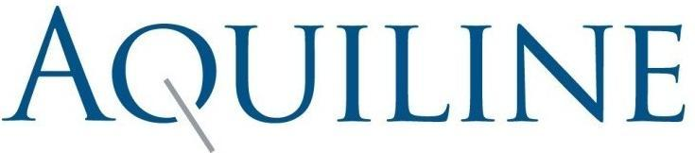






















Appendix
Insurance Brokerage Precedent Transactions
EV / EBITDA MULTIPLES – SELECTED TRANSACTIONS
UK
Continental Europe
US and Canada
2021-2026 Median⁽¹⁾ 17.3x
2020 Median: 13.3x
Target
Acq.
EV
$7.7bn
$2bn
n.d.
$850mm
$949mm
$5,184mm
£450mm
$526mm
€640mm
£1.2bn
£2.0bn
~€100mm
€0.9bn+
n.d.
£1.75bn
€2.3bn
€0.9bn+
$1.6bn
A$1.1bn+
£1.5bn+
$7.5bn
n.d.
£2.5bn
£1.1bn
€2.5bn
€380mm
$12bn
n.d.
n.d.
n.d.
n.d.
£680mm
$2.7bn
€200mm
c.€47m
£1.9bn
€160mm
€90mm
€1.3bn
$326mm
Country
Source: Press, Company Filings, Mergermarket
Note: (1) Median excludes EQT acquisition of CFC.

Slide 23
Appendix
TBU
Publicly Traded Comparables
Source: Capital IQ as of 19 June 2026.

